Slide 1
NAT and FW Traversal
Shawn Chen (Borrow some slides from Liu Bin)
May, 2017

Slide 2
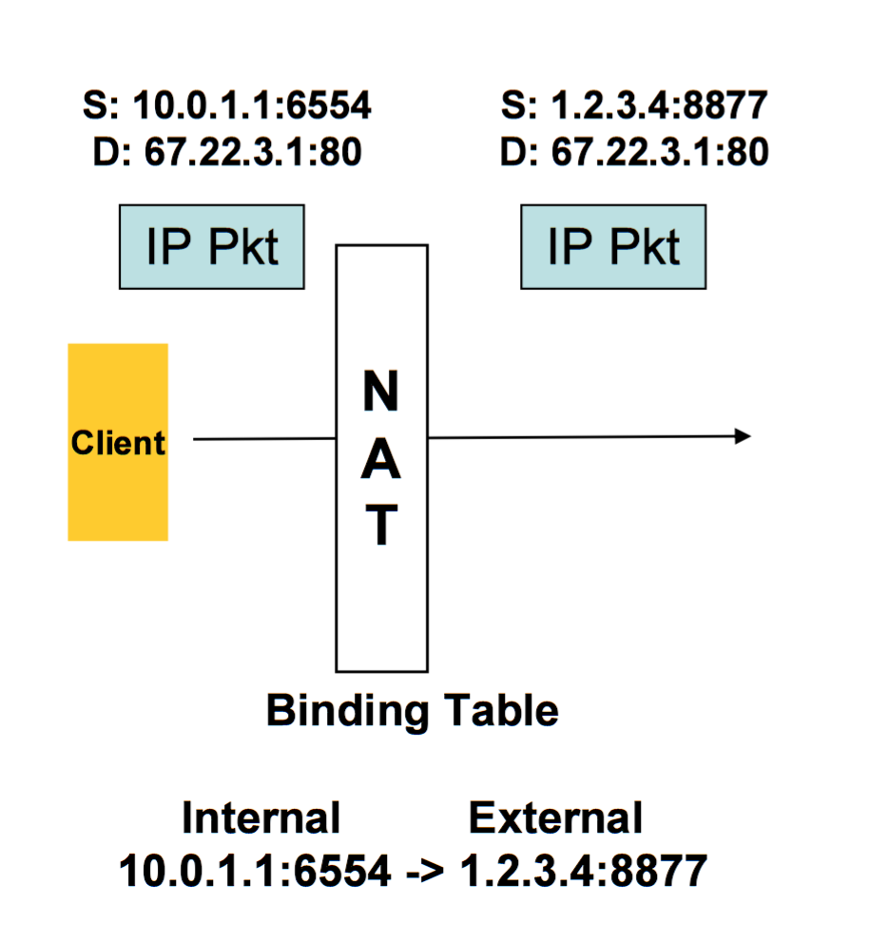
What’s NAT?
Network Address Translation(NAT)
Creates address binding between internal private and external public address.
Modifies IP Addresses/Ports in Packets
Benefits
> Avoid network renumbering on change of provider
> Allows multiplexing of multiple private addresses, save money.
Maintains privacy of internal addresses.

Slide 3
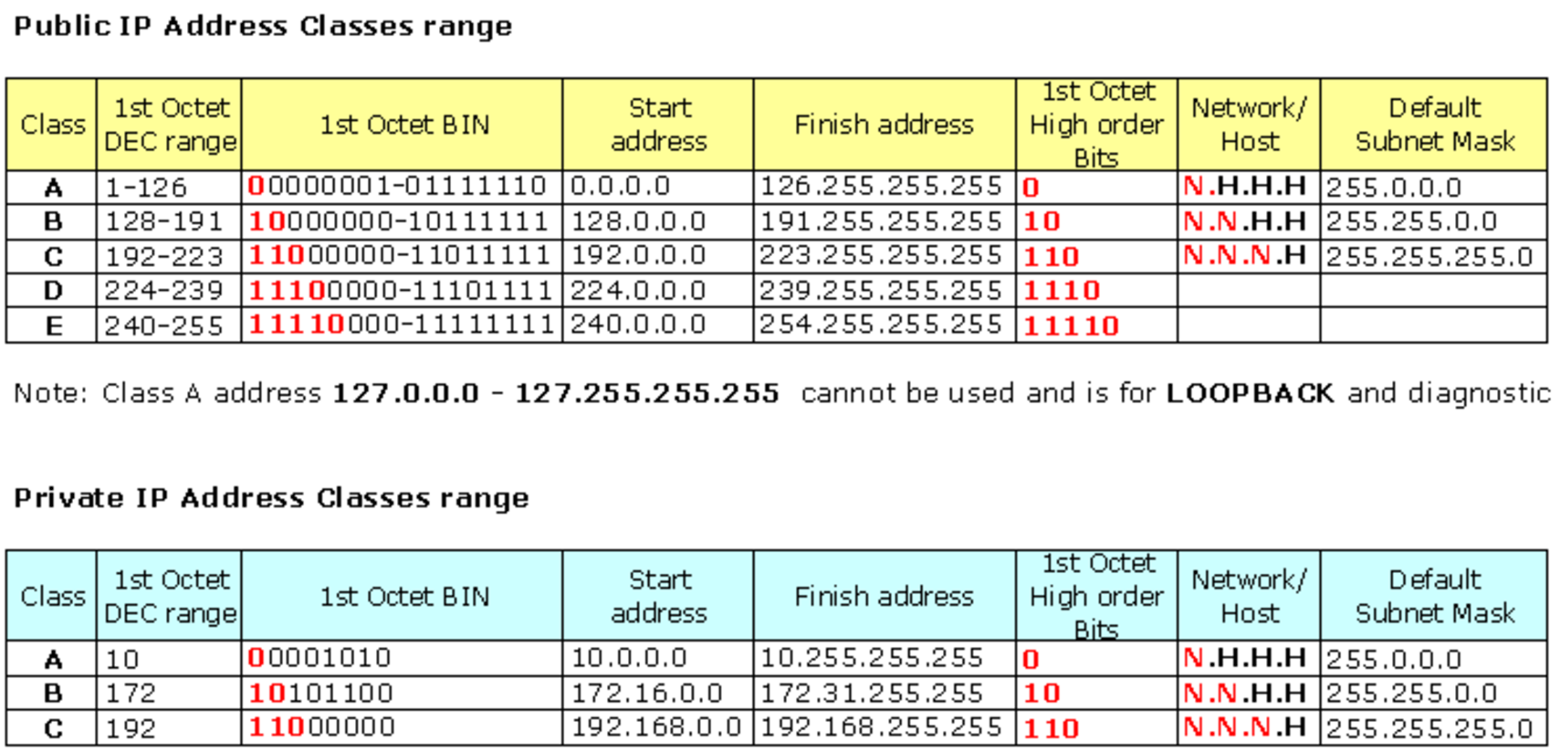
Public and Private IP addresses

Slide 4
Types of NAT
Full Cone NAT
Restricted Cone NAT
Port restricted Cone NAT
Symmetric NAT

Slide 5
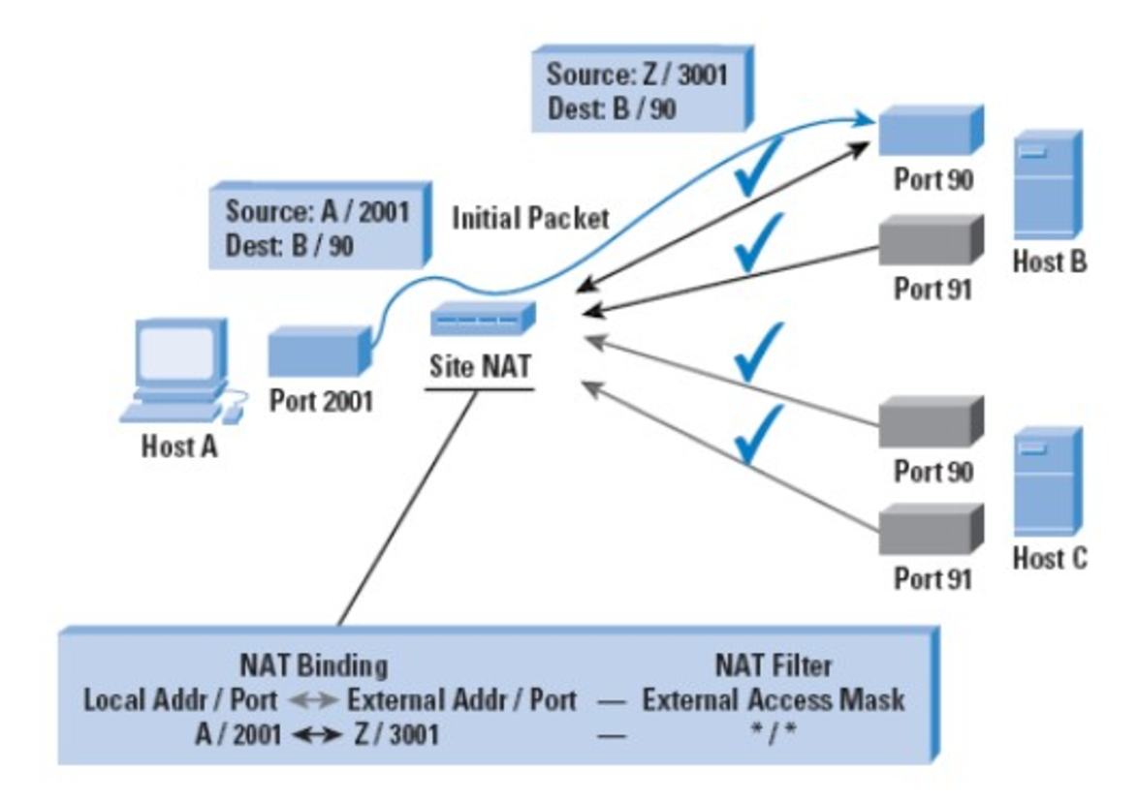
Full Cone NAT

Slide 6
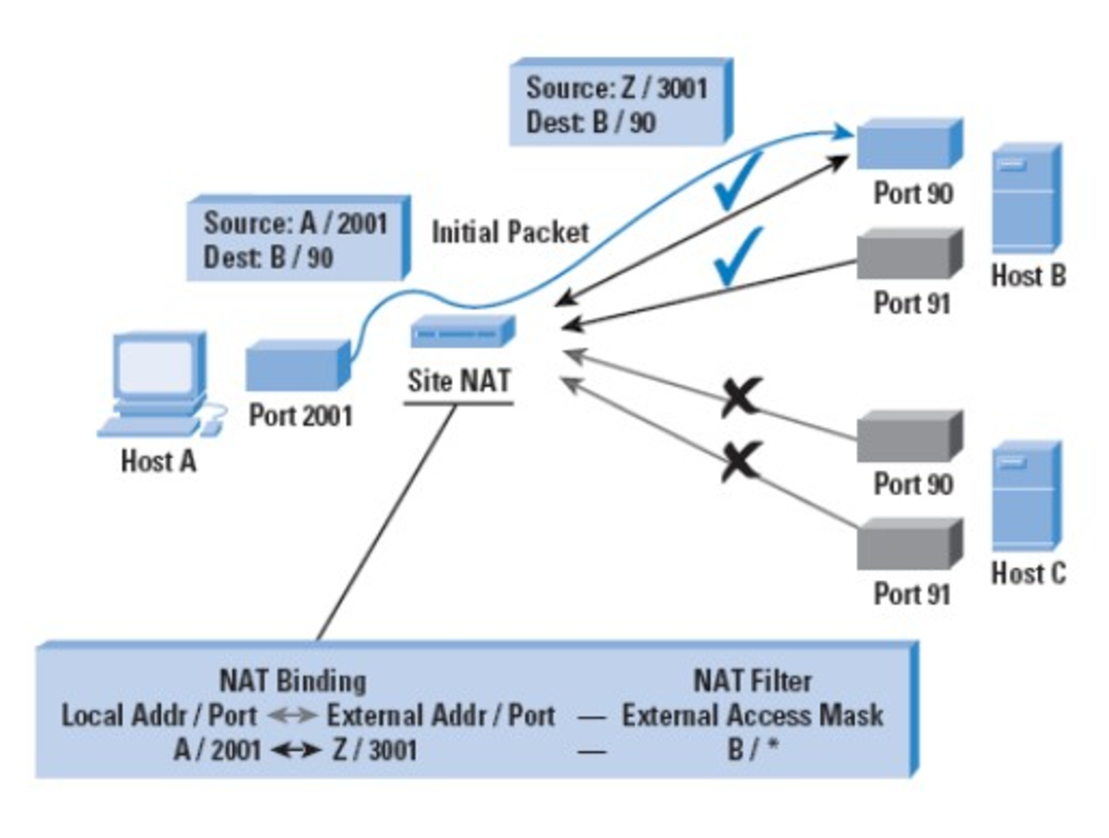
Restricted Cone NAT

Slide 7
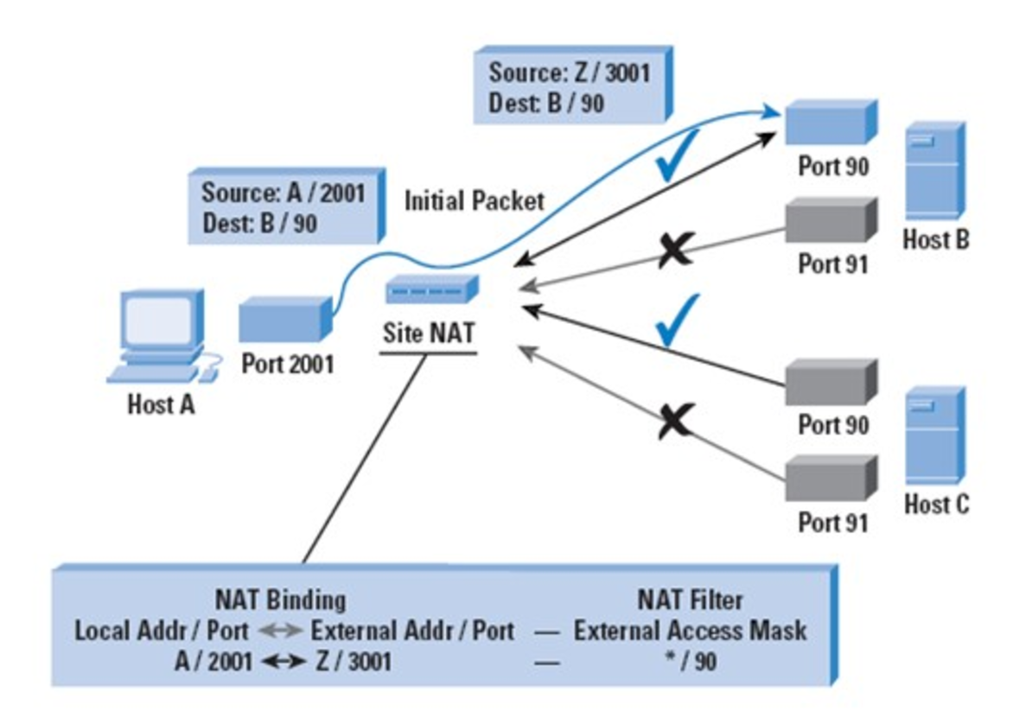

Port-Restricted Cone NAT

Slide 8
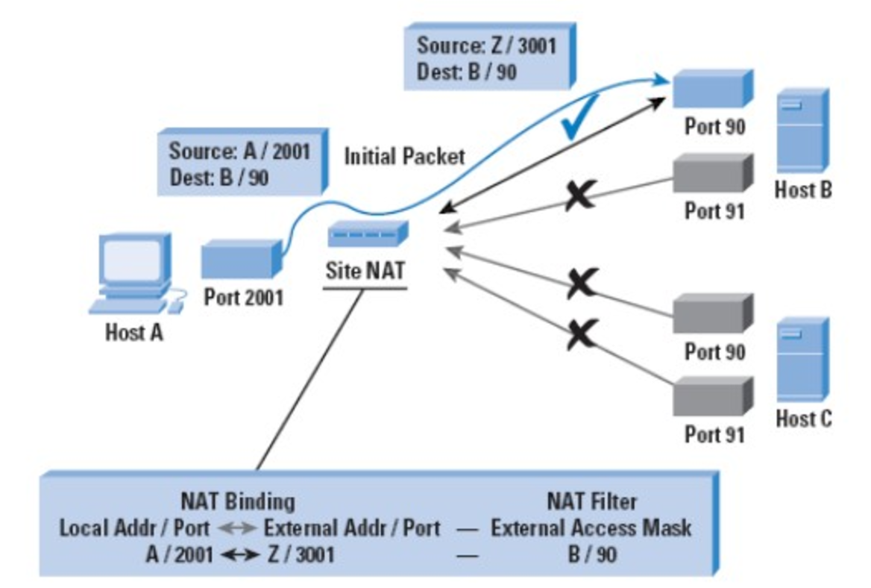
Symmetric NAT

Slide 9
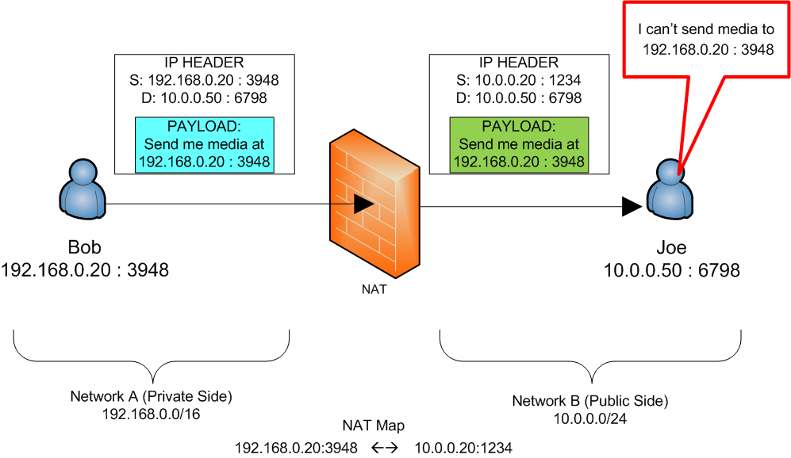
The Basic NAT Issue (simple)
NAT firewalls alter packet addresses on one side of the firewall, but don’t change the payload of the packets.

Slide 10
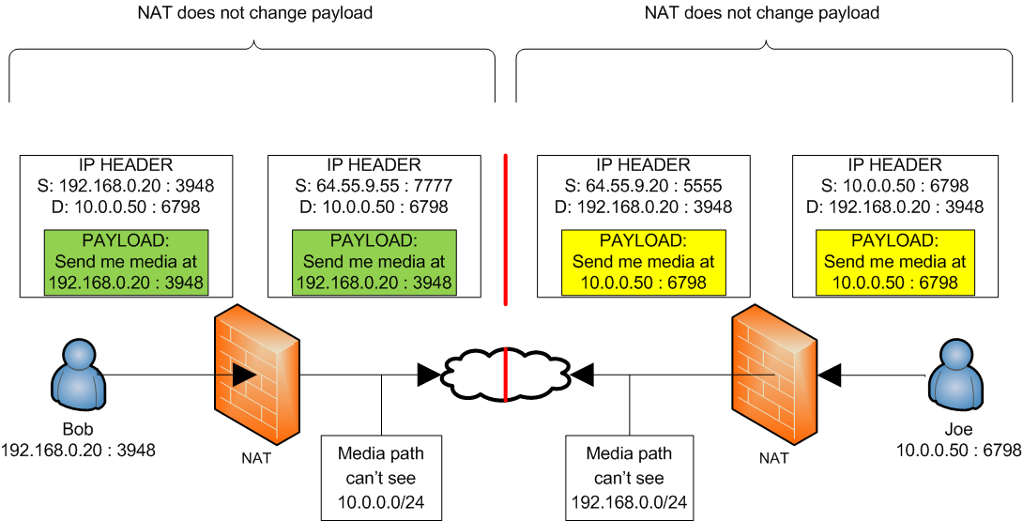
The Basic NAT Issue (realistic)
A more realistic example of the NAT issue using 2 firewalls, one for each endpoint.

Slide 11
Technologies to Resolve NAT issue
ALG(Application Layer Gateway)
MIDCOM(Middlebox Communication)
STUN(Session Traversal Utilities for NAT)
TURN(Traversal Using Relays around NAT)
ICE(Interactive Connectivity Establishment)
SBC(Session Border Controller)

Slide 12

STUN
STUN --- Session Traversal Utilities For NAT
Help the Client discover its Reflective Address
Keep Hole Alive
Nonsupport TCP protocol
TLV coding
Message
0x0001 : Binding Request 0x0101 : Binding Response 0x0111 : Binding Error Response 0x0002 : Shared Secret Request 0x0102 : Shared Secret Response 0x0112 : Shared Secret Error Response

Slide 13
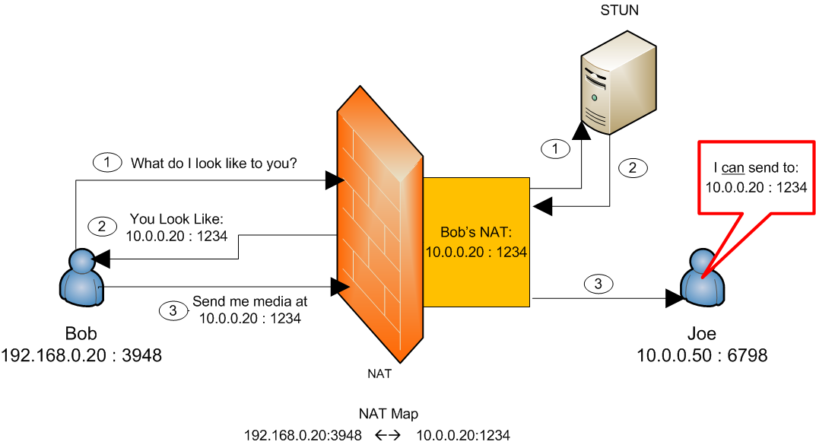
Basic STUN
A STUN server sits on the opposite side of a firewall and allows an endpoint to ask what its address on the other side of the firewall is. That endpoint can then use this address instead of its local one for media.

Slide 14
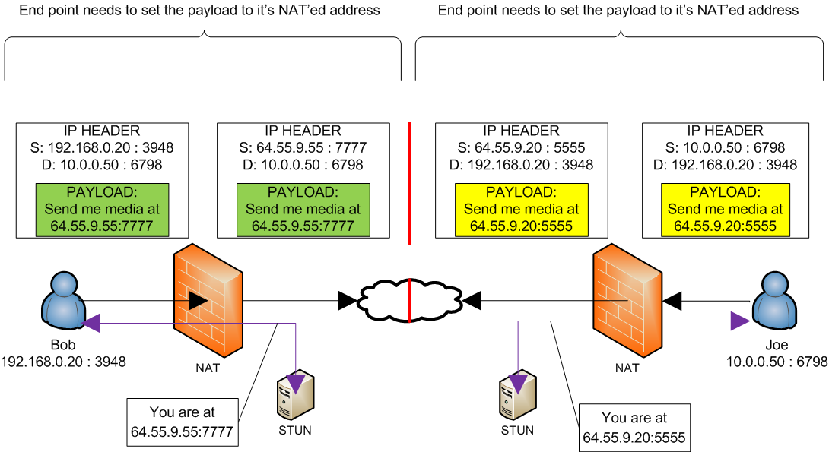
More Realistic STUN

Slide 15
TURN
TURN---Traversal Using Relays around NAT
Used by client to allocate Relayed Transport address on TURN
Server establishes forward mapping table
TURN messages are packaged within a STUN message header
Message Type:
0x0003: Allocate request
0x0103: Allocate response
0x0004: Send request
0x0115: Data Indication
0x0006: Set Active Destination request
0x0106: Set Active Destination response

Slide 16
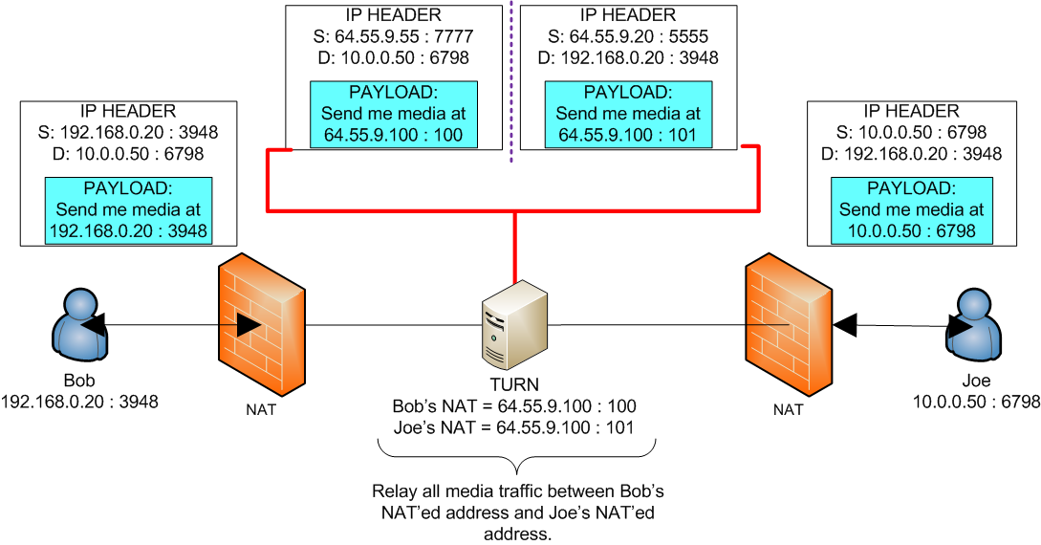
TURN
A TURN server is just a media relay.

Slide 17
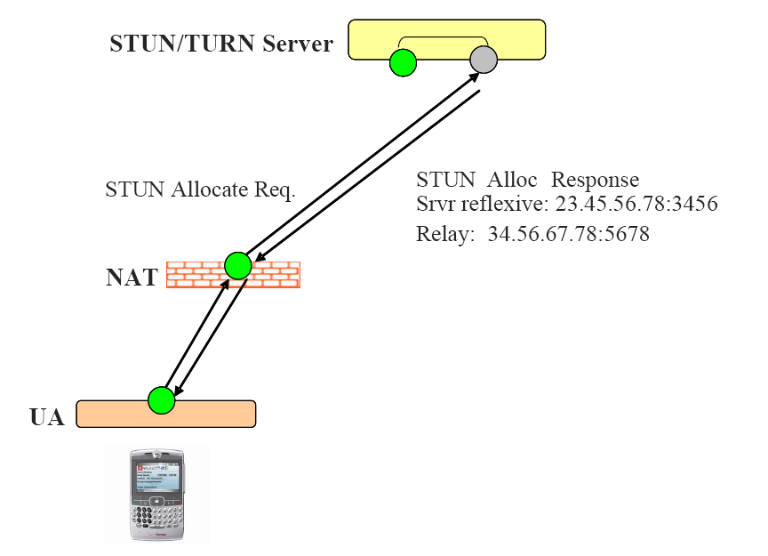
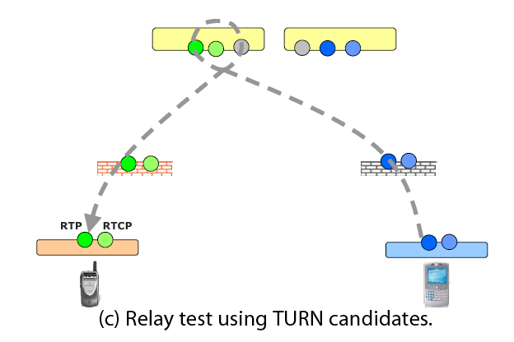
Turn Flow

Slide 18
ICE
ICE---Interactive Connectivity Establishment
Make use of TURN and STUN messages to gather candidate address (host, reflective, relay address)
Send the address pairs in SIP SDP
Make Use of STUN to perform Connectivity Checks on these address pairs
Signal the remote endpoint on winning pair via the USE-CANDIDATE attribute in the STUN signaling
Start Media upon successful Connectivity Checks

Slide 19
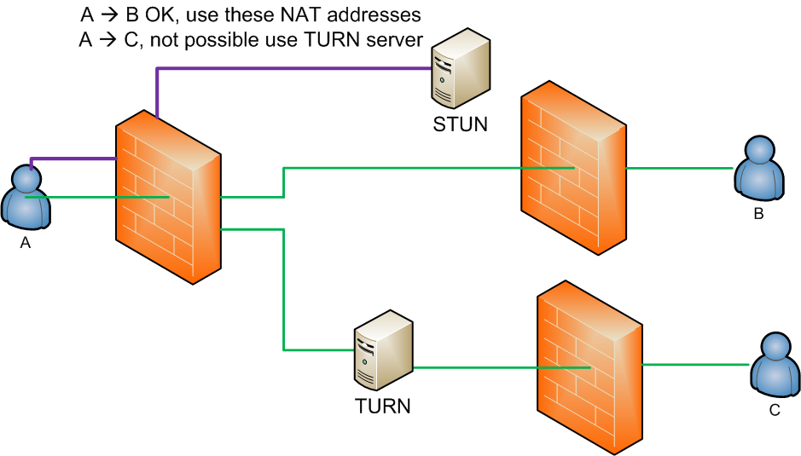
ICE
Tries to use the less expensive STUN, but if media connectivity can not be established with STUN it will then specify the use of TURN.
19

Slide 20
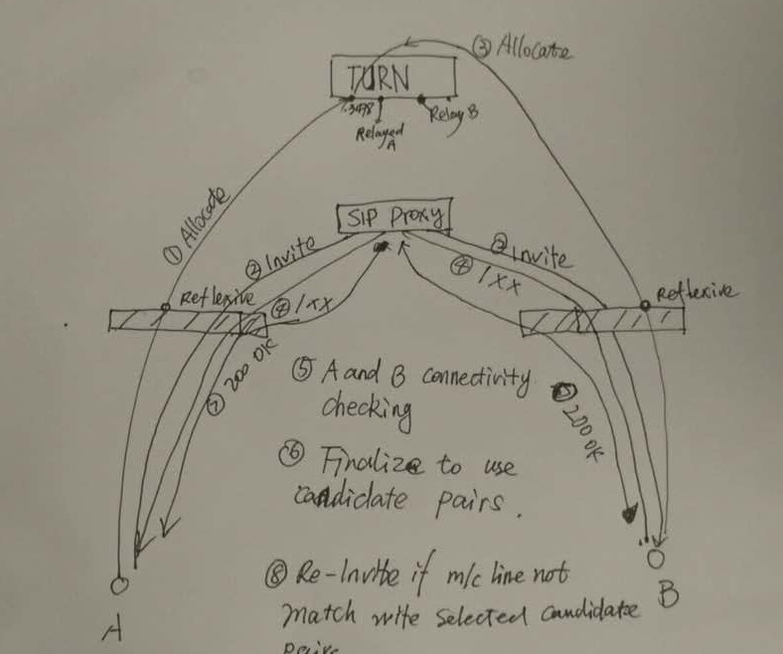
Sample illustration

Slide 21

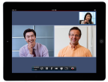







RPAD Topology
SIP Remote User
SIP endpoints
RealPresence Access Director
HDX
RPM
…
XMA
Access Proxy
HTTPS
HDX
DMA
LDAP
Unregistered User
XMPP
Internet
RPM
Home FW
Router
RPM
SIP Service
SIP
…
RMX
H.323 Service
Enterprise B
Private
FW
H.323
Public
FW
RPAD
RPM
RSS
Media Traversal
RPM
MTC/MTN
DMA
H.323 endpoints
DMZ

Slide 22
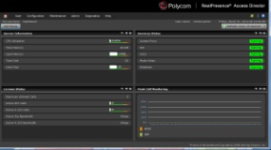
RPAD Architecture
SNMP Mgt.
XMA
Syslog Server
AD Server
NBI
WEB Management
SNMP
VC2
LDAP
Flex GUI
SNMP Agent
VC2 Agent
Admin
Maintenance
Configuration
User
Core Services
Service Controller
DBA
Web Proxy (+TCP MTN)
Log
License Controller
PostgreSQL
Access Proxy
DNS Resolver
Policy Controller
Auditor Master
Tunnel Server
Tunnel Client
SIP Core Service
H.323 Core Service
System Controller
Media Traversal Controller
Stack
System Controller
Media Traversal Controller
SIP Stack
H.323 Stack
System Security
Media Traversal Network
VMware Tools
UDP Media Traversal Node

Slide 23
RPAD Access Proxy
XMA
WEB Management
Flex GUI
User
Maintenance
Configuration
Admin
VC2 Agent
Core Service
HTTPS Access Proxy
H.323 Core Service
SIP Core Service
HTTPS
PostgreSQL
LDAP Access Proxy
LDAP
XMPP AccessProxy
XMPP
Stack
System Manager
H.323 Stack (Radvision)
SIP Stack (Jain SIP)
System Controller
Media Traversal
System Security
Media Traversal Controller
Media Traversal Node

Slide 24

Reverse Proxy for HTTPS

Slide 25
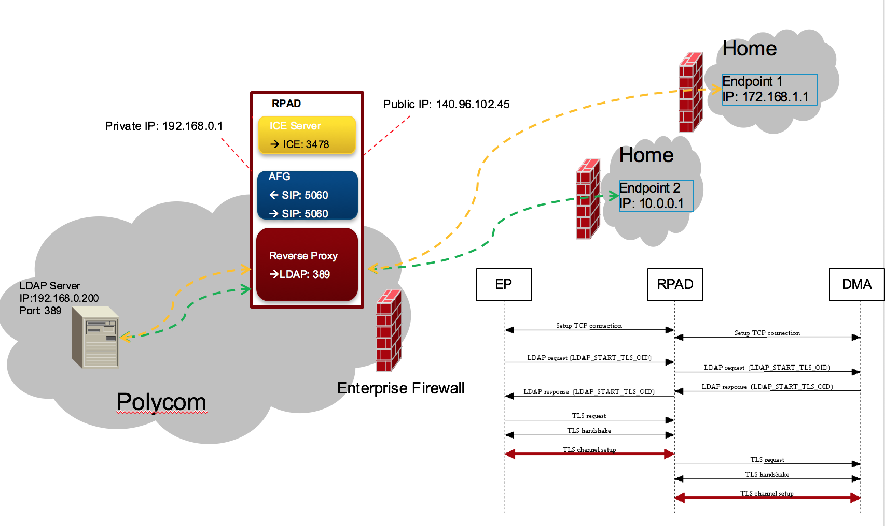
Reverse Proxy for LDAP
RPAD listens LDAP port (389) in the public side;
When receiving connection request from remote endpoint, RPAD accept it and create a new connection request to LDAP server (CMA)
RPAD maintains the mapping between 2 sets of connections
The LDAP request is transparently forward between endpoint and LDAP server
When endpoint request to setup the TLS connection and get LDAP server’s response, endpoint may create TLS request to AS to setup the TLS connection
RPAD access the TLS request and setup the TLS channel with endpoint
RPAD request LDAP server to setup the 2nd section TLS connection
All LDAP data will be transferred in TLS channel from now on
RPAD is responsible for encrypt and decrypt the payload between 2 sections

Slide 26
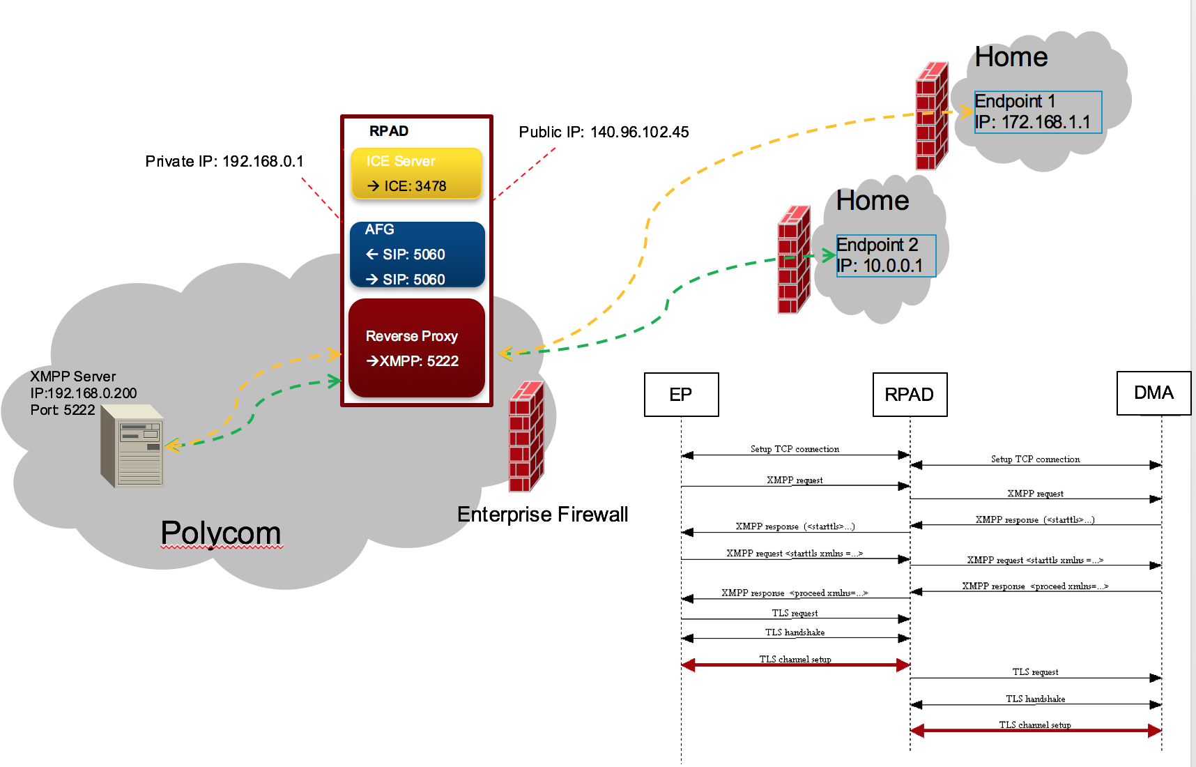
Reverse Proxy for XMPP
RPAD listens XMPP port (5222) in the public side;
When receiving connection request from remote endpoint, RPAD accept it and create a new connection request to XMPP server (CMA)
RPAD maintains the mapping between 2 sets of connections
The XMPP request is transparently forward between endpoint and XMPP server
When endpoint request to setup the TLS connection and get XMPP server’s response, endpoint may create TLS request to AS to setup the TLS connection
RPAD access the TLS request and setup the TLS channel with endpoint
RPAD request XMPP server to setup the 2nd section TLS connection
All XMPP data will be transferred in TLS channel from now on
RPAD is responsible for encrypt and decrypt the payload between 2 sections

Slide 27
RPAD SIP Traversal
XMA
WEB Management
Flex GUI
User
Maintenance
Configuration
Admin
VC2 Agent
Core Service
HTTPS Reverse Proxy
H.323 Core Service
SIP Core Service
LDAP Reverse Proxy
PostgreSQL
XMPP Reverse Proxy
Stack
System Manager
H.323 Stack (Radvision)
SIP Stack (Jain SIP)
SIP Signal
System Controller
Media Traversal
System Security
Media Traversal Controller
Media Traversal Node
Media

Slide 28
RPAD H.323 Traversal
XMA
WEB Management
Flex GUI
User
Maintenance
Configuration
Admin
VC2 Agent
Core Service
HTTPS Reverse Proxy
H.323 Core Service
SIP Core Service
PostgreSQL
LDAP Reverse Proxy
XMPP Reverse Proxy
Stack
System Manager
H.323 Stack (Radvision)
SIP Stack (Jain SIP)
H.323 Signal
System Controller
Media Traversal
System Security
Media Traversal Controller
Media Traversal Node
Media

Slide 29
RPAD Media Traversal
XMA
JNI
WEB Management
Flex GUI
MTN Wrapper
I/O Control
User
Maintenance
Security
Configuration
Admin
VC2 Agent
Linux Application
Log Setting
Local Output
Linux User Space
Local Input
Linux Kernel
Core Service
HTTPS Reverse Proxy
Routing?
SIP Core Service
H.323 Core Service
Forward
POSTROUTING
PostgreSQL
LDAP Reverse Proxy
hook
XMPP Reverse Proxy
PREROUTING
hook
MTN Driver
(Kernel Module)
Stack
System Manager
H.323 Stack (Radvision)
SIP Stack (Jain SIP)
NIO
System Controller
Media Traversal
System Security
Media Traversal Controller
Media Traversal Node
Media

Slide 30
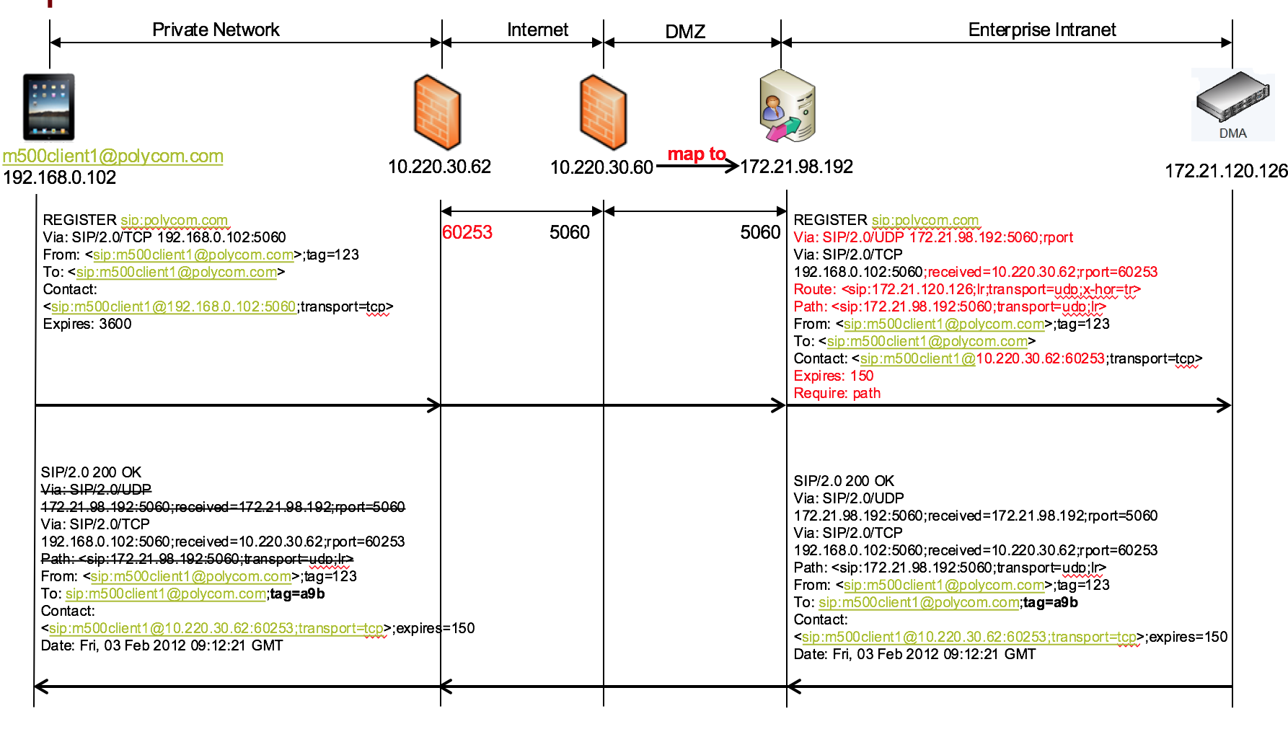
SIP Register

Slide 31
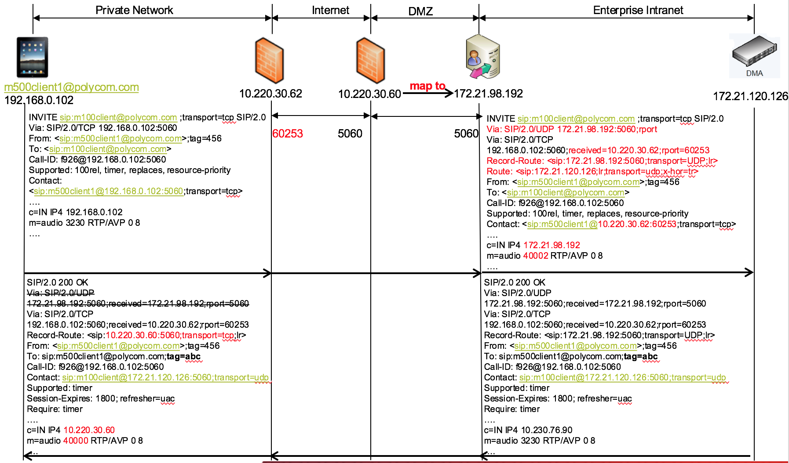
External Call Enterprise

Slide 32
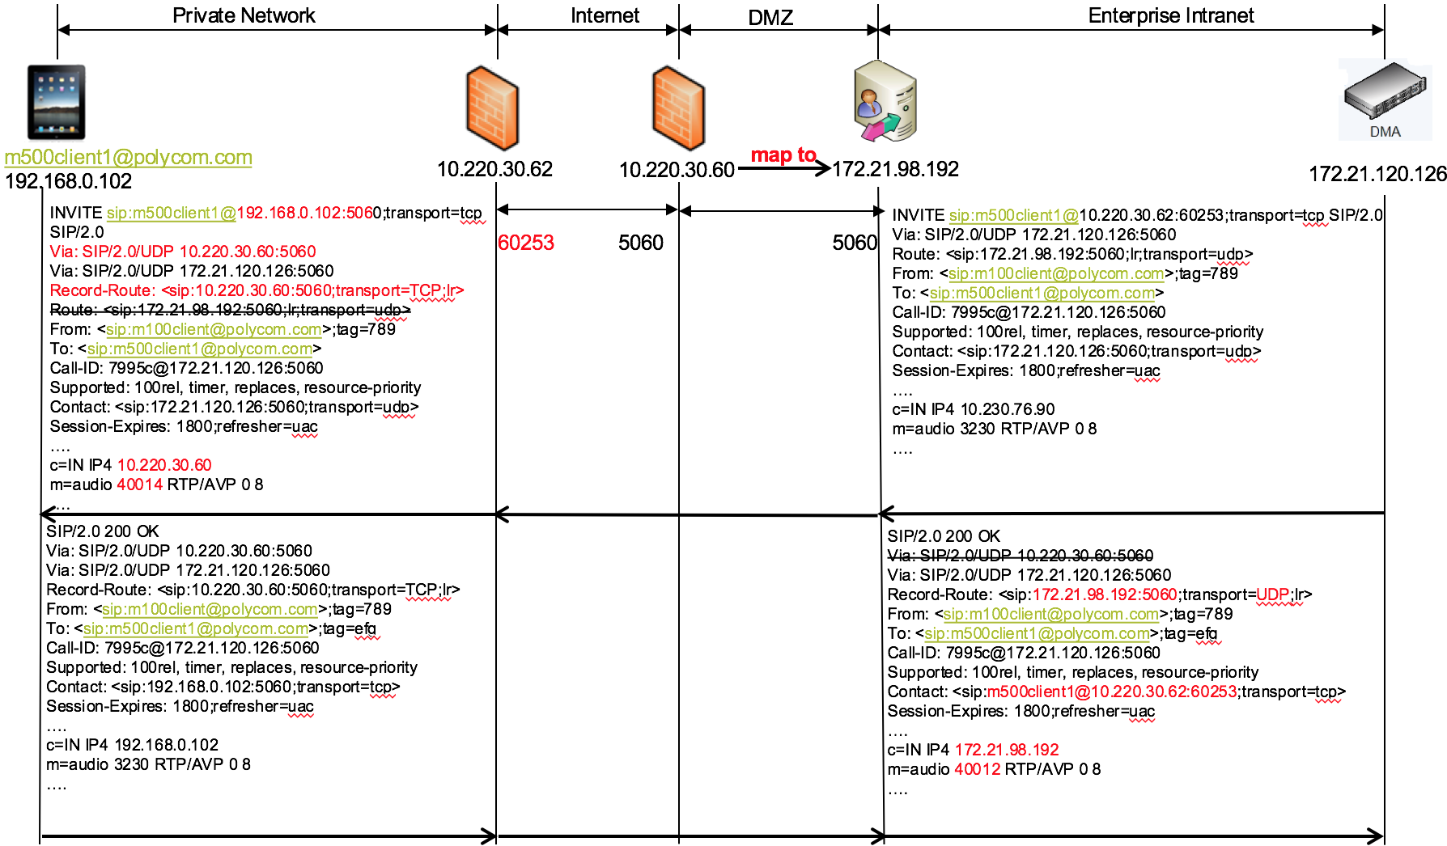
Enterprise call External

Slide 33
Trust B2B Scenario for SIP

Slide 34
H.323 Traversal

Slide 35
Trust B2B Scenario for H.323

Slide 36
HTTP Tunneling
MEA request (webSocket)
Backend servers
(XMA, MEA, CDR…)
Access Proxy - HTTP proxy
IP1: 443
SIP over TLS
IP2: 443
Web Proxy
SIP
Media over TCP
TCP MTN
MTC
DMA
Media over UDP
MCU
Web Proxy tunnel SIP signal and Media only
SIP over TLS
RTP over TCP on external side and UDP on internal side
Support the tunneling EP and non-tunneling EP meanwhile
For tunnel EP
SIP to RPAD Web proxy
Media to RPAD Web proxy
MEA message to Access proxy

Slide 37
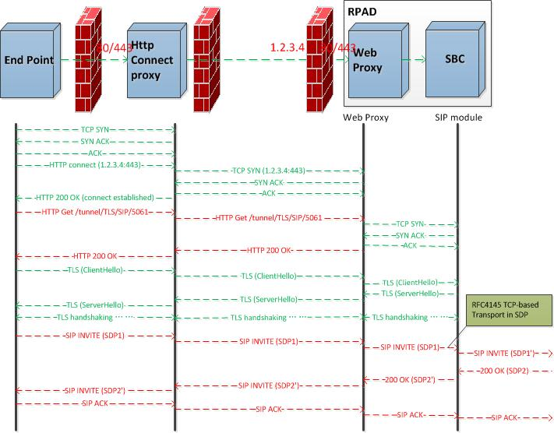
HTTP Tunneling(SIP signal over TLS)
Web Proxy
Initialized TCP socket server on 80/443
Resolve the first HTTP request to identify the connection
TLS handshake and SIP signal are transparent
SIP signal module
Listen on 5061 for TLS access
Support TCP based SDP on WAN side (RTP over TCP only)
Support UDP based SDP on LAN side (RTP over UDP only)
BFCP over TCP only

Slide 38
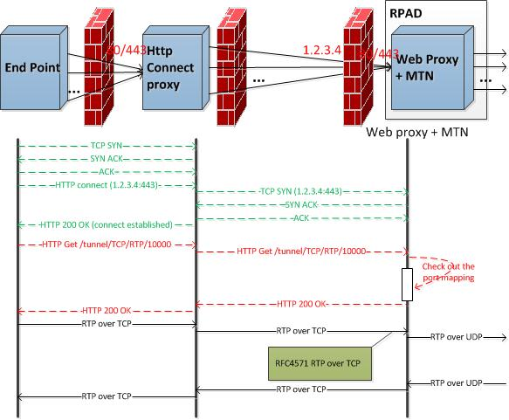
HTTP Tunneling(Media over TCP)
Web Proxy
Initialized TCP socket server on 80/443
Resolve the first HTTP request to identify the connection
TCP MTN
Store the media relay rules
On WAN side, framing and de-framing RTP packets over TCP connection (RFC4571) for audio, video, FECC and SCP
On LAN side, encapsulate and de-capsulate the UDP packets for all media channels

Slide 39
ACL
Policy Controller
H.323 Core Service
Rule 1
Condition
Action
Rule 2
Condition
Action
Rule 3
Condition
Action
…
match
Signaling object
Signaling object
match
SIP Core Service
no match
Rule 1 Action
Rule 2 Action
Permit
/ Deny
Rule 2 Action
Rules are defined with priority
ACL API is called by H.323 and SIP service when receiving the new requests
The return action is Permit or Deny

Slide 40
Two box TLS tunnel
TLS Tunnel
Encrypted Data
RPAD (outer box)
RPAD (Internal box)
Core Services
Tunnel Client
Tunnel Client
Core Services
MAC
IP
IP
UDP
TCP
UDP
IP
IP’
Data
TCP
UDP
TCP
UDP
Data
Data
Layer 4 / Data
Layer 4 / Data
Source IP changed
Layer 3 / Transport
Encryption
Layer 3 / Transport
Layer 2 / IP
Layer 2 / IP
Layer 1 / MAC

Slide 41
Thanks!

